Slide 1
Dual-axis solar tracking

Slide 2
Question
How to maximise the efficiency of solar power?

Slide 3
Hypothesis
The dual-axis tracker will keep the solar panel nearly perpendicular to the sun's rays at all times, minimizing the incident angle. This continuous, optimal alignment will allow the panel to capture the maximum amount of solar radiation throughout the day, thus generating more power.

Slide 4
Background information
The primary challenge in solar energy is maintaining maximum power output, as fixed panels experience significant efficiency loss when the sun moves, striking the surface at a shallow incident angle. This project investigates the solution: a dual-axis solar tracker. This system uses Light Dependent Resistors (LDRs) to detect the sun's position and commands servomotors to continuously adjust the panel's Azimuth (East-West) and Elevation (Up-Down). This closed-loop control system ensures the panel remains perpendicular 90 degree to the sun's rays, maximizing solar irradiance and energy yield throughout the day compared to a stationary setup.

Slide 5
Materials
Acrylic board + Wooden board 3mm*4
Keyestudio uno board
Photoresistor module (LDR) *4
Temperature and humidity sensor
Solar USB charging module
USB cable
Push button module
I2C1602 module (LCD display)
BH1750FVI digital light intensity module
1.5 W PET solar panel ( Size: 137mm x 85 mm)
Smart phone charging module
Servo mount kit +Servo motor * 2

Slide 6
Procedures
Assemble acrylic boards.
Assemble microcontroller board and other required electrical components on the board.
Build a servo mount kit to attach vertical and horizontal servos.
Initialize both servo motors to corresponding angels.
Mount the solar panel on the board.
Connect electrical components to the microcontroller board.
Wiring the vertical and horizontal servos to the microcontroller board.

Slide 7
Results
Based on experimental testing in Mandalay, this project conclusively demonstrates the superior performance of a dual-axis solar tracker. The tracker, which uses light sensors to follow the sun's path, produced 33% more energy than a stationary panel. This significant increase, from 19.01 Watt-hours to 25.27 Watt-hours, confirms our hypothesis and proves that active tracking effectively maximizes solar energy capture throughout the day.

Slide 8
Conclusion
The Dual-Axis Tracker 33% more total electrical energy than the fixed panel, which falls within the hypothesized range of 25% to 40 % increase. This is because the tracker successfully maximized solar capture by maintaining a nearly perpendicular angle to the sun throughout the day.

Slide 9
Independent variable
Active dual-axis tracking (horizontal and vertical alignments)
Dependent variable
Electrical power output (in Wh)
Controlled variables
Solar panel size
Location and weather

Slide 10
Reference
KS0530 Keyestudio Solar Tracking DIY Kit for Arduino - Keyestudio Wiki
kanak108/Dual-Axis-Solar-Tracker-Controller: Accurately controls the position of Solar panels to align them to get maximum sunlight, thus producing the maximum energy.
How Solar Trackers Work

Slide 11
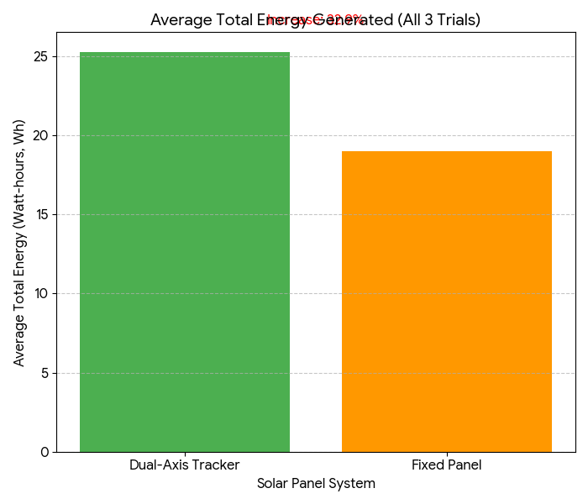
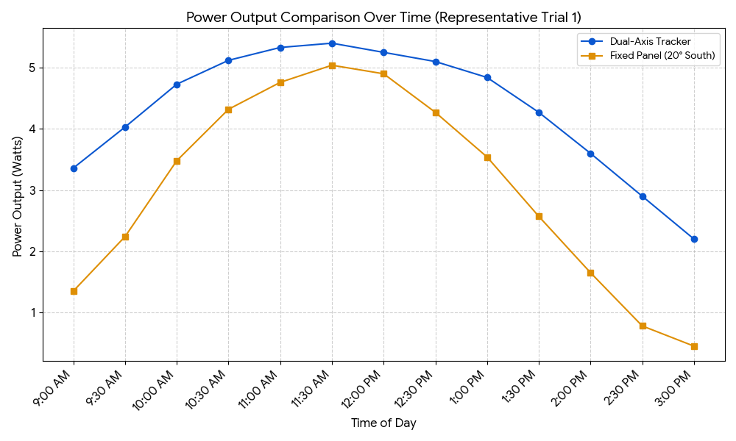
Graph

Slide 12
Group members
Aye Chan Zay
Nyi Nyi Phyo
Twal Tar Wint Hlaing
May Myat Noe San
Zue Yati Ko

Slide 13
Abstract
This project builds a dual-axis solar tracker to maximize energy capture. It uses four light sensors (LDRs) to constantly compare light levels on different sides of the solar panel. A small computer (Arduino) reads these sensors and performs simple subtraction to determine where the sun is brightest. Using this data, it calculates new positions for two servo motors, which tilt and rotate the panel towards the light. This continuous adjustment ensures the panel always faces the sun directly, significantly increasing its efficiency compared to a stationary panel.

